Slide 1
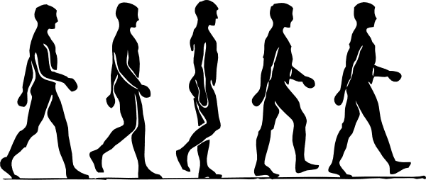

3:00 PM CHP Sullivan Center June 7, 2023
Model-based Approaches to Objective Inference During Steady-state and Adaptive Locomotor Control
Pouria Nozari
Ph.D. Dissertation Defense
USC Viterbi
USC University of
Southern California
School of Engineering

Slide 2
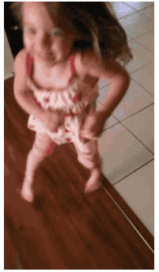
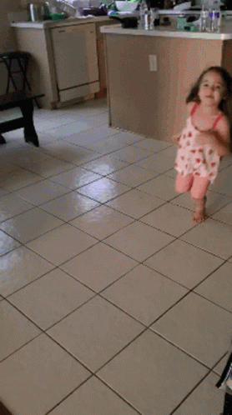
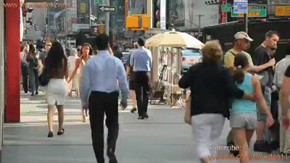

Slide 3

Normative theories on human motor control:
Behaviors are selected based on cost evaluation
Behaviors selected based on evaluation of their cost
Reinforcement learning ⁴
Supervised learning ⁵
Gradient descent ^{6, 7}
Cost ⁸
A scalar functional of controls and/or states
Evaluate and compare the goodness of strategies
Examples of costs
Energy expenditure or effort ⁹; Stability loss ¹⁰; Fatigue ¹¹; Pain and emotional states
[1] Valero-Cuevas et al., IEEE Rev Biomed Eng, 2009
[2] Schaal & Schweighofer, Curr Opin Neurobiol, 2005 [3] Latash et al., Medicina, 2010
[4] Sutton & Barto, J Cog Neurosci, 1999
[5] Haruno et al., Adv Neur Info, 1999
[6] Todorov & Jordan, Nature Neurosci, 2002
[7] Friston, Neuron, 2011
[8] Jordan & Wolpert, Cogn Neurosci, 1999
[9] Alexander, Energy for Animal’s Life, 1999
[10] Cooper et al., Gait & Posture, 2008
[11] Enoka, J Physiol, 2008
3

Slide 4
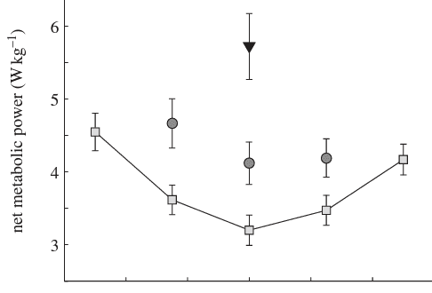
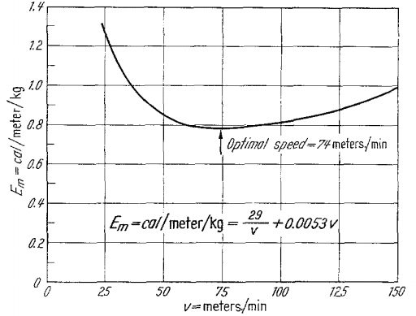
Energy economy explains several features of self-selected gait
People adopt stride times and speeds that minimize energetic cost
Symmetric
Moderately symmetric
Highly asymmetric
Metabolic Cost of Transport
4
[1] Ellis et al., The Royal Society (2013). [2] Ralston, Einschliesslich Arbeitsphysiologie (1958)

Slide 5
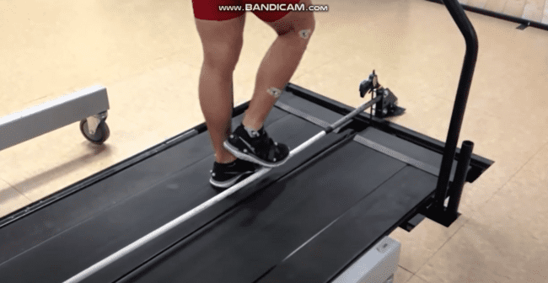
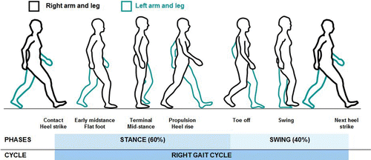






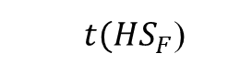


Energy cost may also drive learning in novel conditions
Walking on a split-belt treadmill is a common paradigm to study adaptive walking
Commonly studied spatiotemporal gait features
Fast
Heel-Strike
Slow
Heel-Strike
Fast
Heel-Strike
Step Time Asymmetry
$$STA=\frac{ST_{S→F}−ST_{F→S}}{ST_{S→F}+ST_{F→S}}$$
Step Length Asymmetry
| 3
$$SLA=\frac{SL_{F}−SL_{S}}{SL_{F}+SL_{S}}$$
$$SL_{F}$$
$$SL_{S}$$
Time
5
$t(HS_{F}$)
$$ST_{F→S}$$
$t(HS_{S}$)
$$ST_{S→F}$$
$t(HS_{F}$)
[1] Reisman et al., Brain (2007)

Slide 6
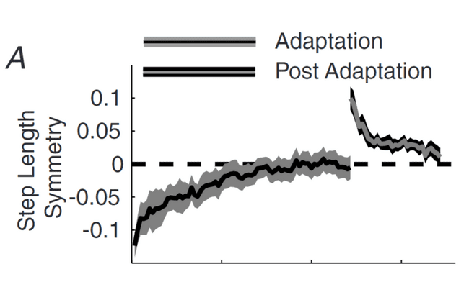
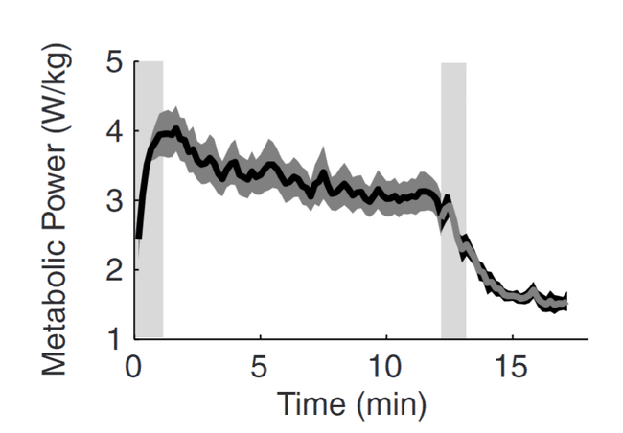
Energy cost may also drive learning in novel conditions
Time course of the decrease in net metabolic power parallels the time course of step length asymmetry adaptation
| 3
6
[1] Finley et al., J Physiol (2013)

Slide 7
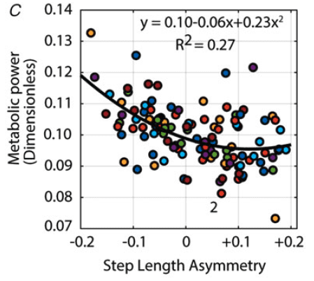
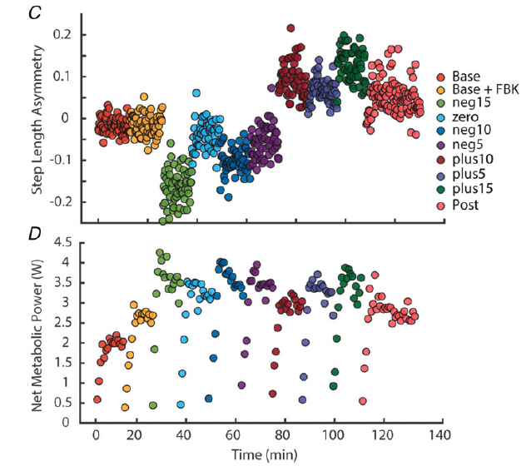
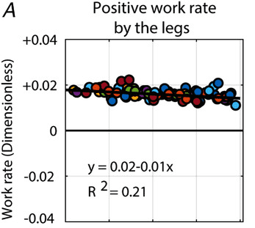
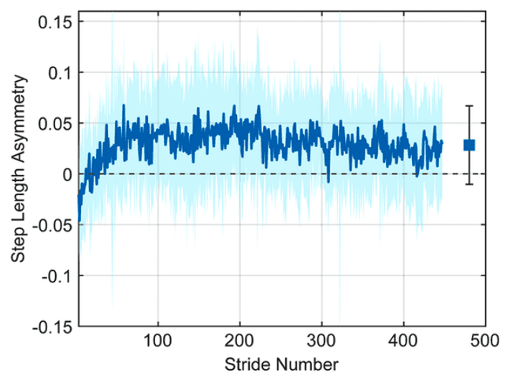
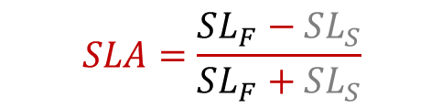
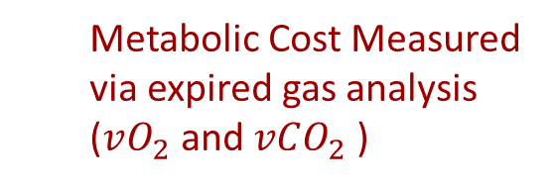
Energy economy may explain spatiotemporal features of adaptive locomotion (Experiments)
$$SLA=\frac{SL_{F}−SL_{S}}{SL_{F}+SL_{S}}$$
➔
| 3
Metabolic Cost Measured via expired gas analysis ($vO_{2}$and $vCO_{2}$)
When free to adapt, individuals adopted positive SLA, corresponding to
Minimum-cost regions
Reduced work rate
7
[1] Sanchez et al., J Physiol (2019)

Slide 8
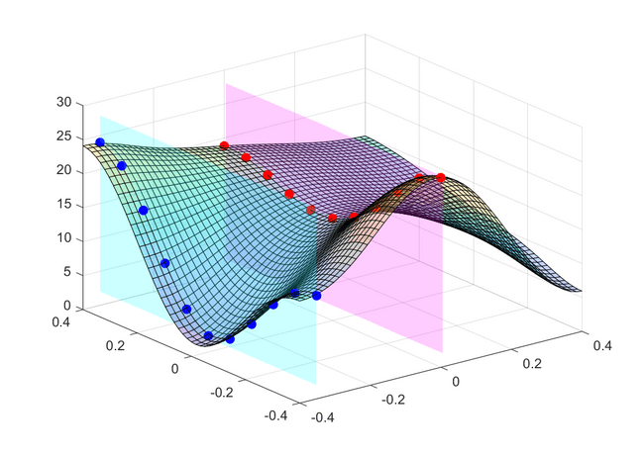
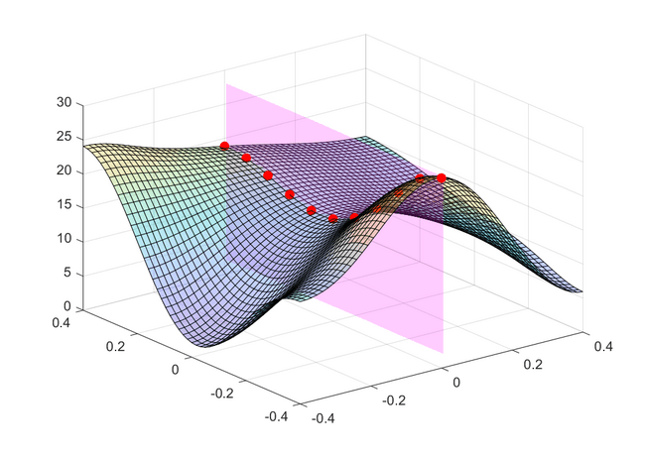
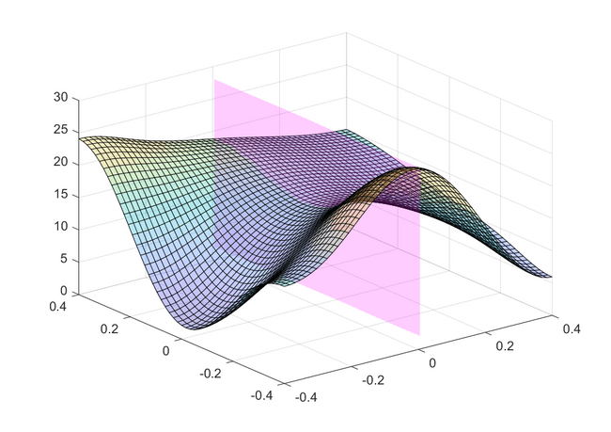
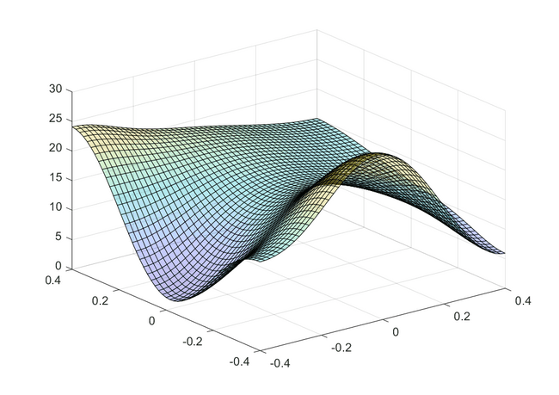
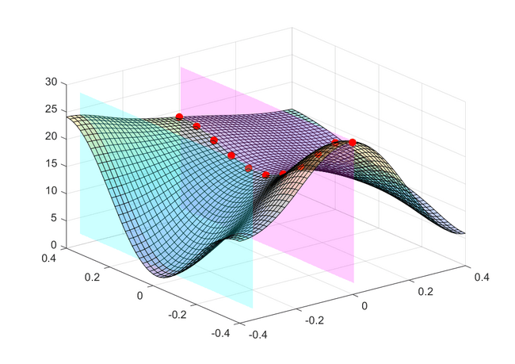
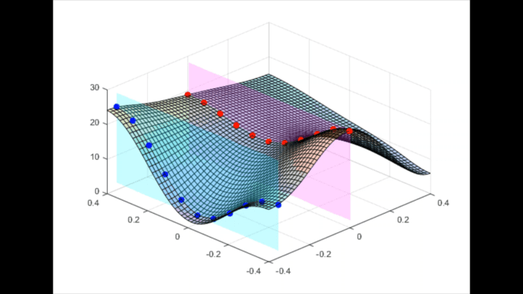
Limitation to Empirical Cost Mapping
Empirical cost mapping cannot evaluate all feasible strategies
Discrete manipulation of a single variable while clamping others is a limitation
Several variables may be optimized together to minimize energy cost
Simulation is a systematic, principled approach to investigating the factors driving motor control
Cost Rate (W)
Step Time Asymmetry = 0
Step Time Asymmetry = - 0.3
Step Length Asymmetry
Step Time Asymmetry
| 3
8
Step Length Asymmetry

Slide 9
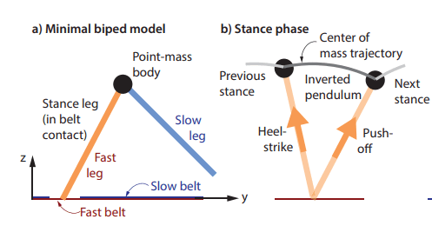
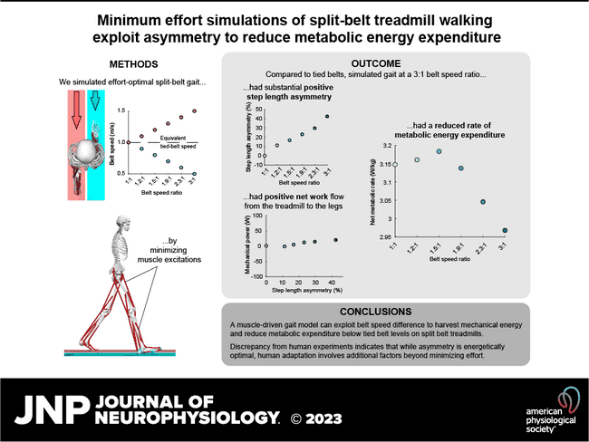
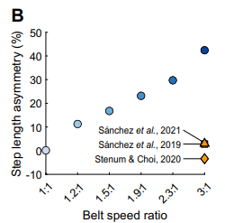
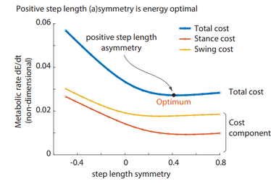
Simulations with energy optimality predict substantially larger asymmetries than empirical observations
9
[1] Seethapathi et al., BioRxiv (2021) [2] Price et al., J NeuroPhysiol (2023)

Slide 10
Limitation to Optimality: Optimality is not guaranteed nor required
Challenges associated with optimization in biology
Requires an accurate representation of the cost
May require a high cognitive load and exploration time
A range of strategies may be selected that are suboptimal but good
May explain behavioral variability
Good-enough Control¹ vs optimality
Intermediate (feasible) Solutions
Global Optimum
Cost
Cost Landscape
Good-enough Region
Relative Improvement
10
Control Variable, e.g., stride time
[1] Loeb, Biol Cybern, 2012

Slide 11
Specific Aim 1
Use simulation-based predictions of gait to characterize a family of “good enough” locomotor behaviors with respect to the energy-related costs
​
​​Hypothesis:
Simulations of split-belt walking will adopt positive step length asymmetries, accompanied by stepping further forward on the fast belt, predicting a range of solutions that were closer to the experimental observations than strictly optimal solutions
11

Slide 12
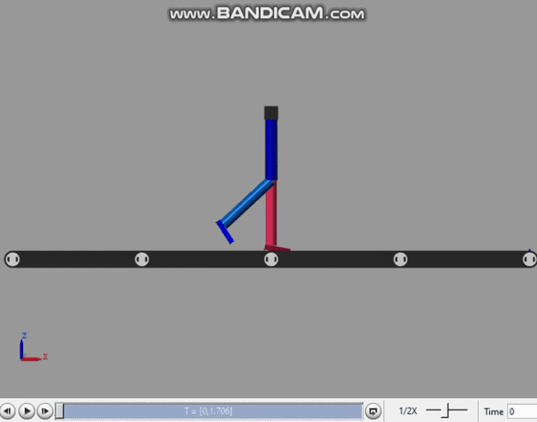
Methods Overview – Aim 1
- Develop a low-D optimization framework using Genetic Algorithm
- Obtain a range of feasible solutions for different belt speed ratios
- Test different effort-related costs
- Estimate the cost landscape based on feasible evolutionary solutions
- Perform a gradient-based search along the surrogate cost
- Perform the search multiple times to obtain a family of good-enough solutions
- Develop the walking Model
- Model split-belt treadmill
- Model control patterns based on Dynamical Movement Primitives
Simulations
1
Evolutionary Optimization
Gradient Descent
Modeling
Feasible Solutions
Potential Good-enough Solutions
Cost
Cost
Optimization Variable, e.g., stride time
Optimization Variable, e.g., stride time
12
[1] Nozari & Finley, IEEE/EMBS NER (2019)

Slide 13
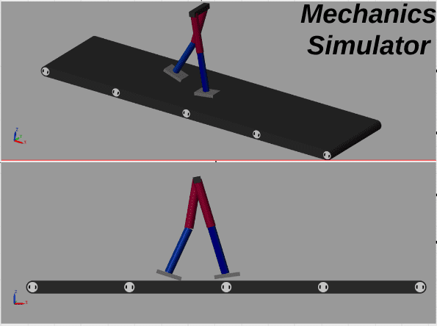

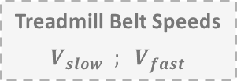
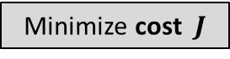
We used Genetic Algorithm to obtain feasible solutions for each belt speed ratio
Evolutionary Optimization
Minimize cost $J$
s.t.
Baseline Trajectories
$$θ_{baseline}$$
Equations of motion
Treadmill Belt Speeds
$$V_{slow} ; V_{fast}$$
&
final position constraints
13

Slide 14
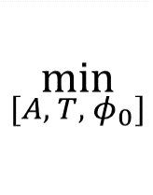
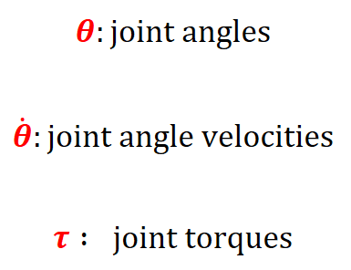
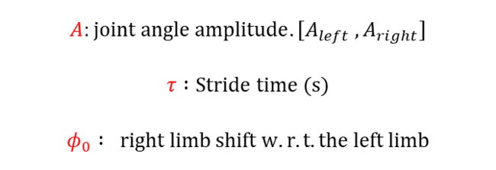
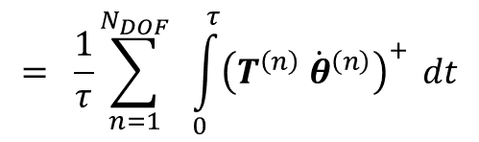
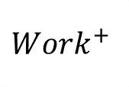
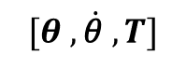
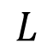
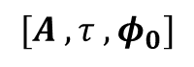

Positive work rate was used as the cost function
$$= \frac{1}{τ}\sum_{n=1}^{N_{DOF}}{ \int_{0}^{τ}{{\left(T^{\left(n\right)} {\dot{θ}}^{\left(n\right)}\right)}^{+}} dt}$$
$$A:joint angle amplitude. [A_{left} , A_{right}]$$
$$τ :Stride time (s)$$
$$φ_{0} : right limb shift w.r.t. the left limb$$
$$Work^{+}$$
$$L$$
$$[A , τ , φ_{0}]$$
$$[θ , \dot{\text{θ}} , T]$$
$$T$$
We modulate the control patterns by varying Amplitude, stride time, and intercoupling
$$τ$$
14
[1] Donelan et al., J Exp Biol (2002) [2] Burdett et al., J Orthop Res (1983) [3] Sanchez et al., J Physiol (2019)

Slide 15
We obtained the map from a wide range of feasible solutions to cost
Evolutionary Optimization
Cost vs. variable for feasible solutions in one dimension
Minimize cost $J$
Cost
s.t.
Baseline Trajectories
$$θ_{baseline}$$
Equations of motion
Treadmill Belt Speeds
$$V_{slow} ; V_{fast}$$
Optimization Variable, e.g., stride time
&
final position constraints
15

Slide 16
A shallow neural network was used to estimate the surrogate cost landscape
Evolutionary Optimization
Cost vs. variable for feasible solutions in one dimension
Minimize cost $J$
Cost
s.t.
Baseline Trajectories
$$θ_{baseline}$$
Equations of motion
Treadmill Belt Speeds
$$V_{slow} ; V_{fast}$$
Optimization Variable, e.g., stride time
&
final position constraints
Neural
Network
Cost surrogate function for feasible solutions shown in one dimension
Cost
16
Optimization Variable, e.g., stride time

Slide 17
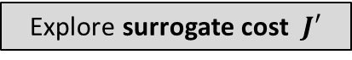
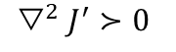
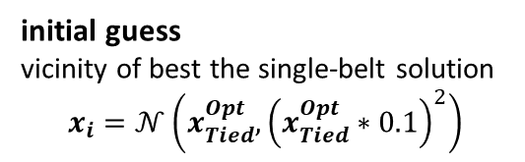
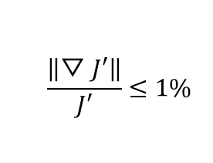
Gradient Descent looked for good-enough solutions along the surrogate cost
Evolutionary Optimization
Cost vs. variable for feasible solutions in one dimension
Minimize cost $J$
Cost
s.t.
Baseline Trajectories
$$θ_{baseline}$$
Equations of motion
Treadmill Belt Speeds
$$V_{slow} ; V_{fast}$$
Optimization Variable, e.g., stride time
&
final position constraints
Neural
Network
Gradient Descent with multiple starts
Explore surrogate cost $J′$
s.t.
Cost surrogate function for feasible solutions shown in one dimension
Initial & final position constraints
Cost
initial guess
vicinity of best the single-belt solution
$$x_{i}=𝒩\left(x_{Tied}^{Opt},{\left(x_{Tied}^{Opt}∗0.1\right)}^{2}\right)$$
stop search when
17
$$\frac{\left.\left\|▽J′\right.\right\|}{J′}≤1\%$$
$$▽^{2}J^{′}≻0$$
&
Optimization Variable, e.g., stride time

Slide 18

The search explored for solutions in the basins around local minima
Start: Vicinity of the best solution from single-belt walking
Algorithm:
Find the nearest solution that is feasible and has a shallow gradient
Repeat with random starts
Split-belt
Positive Work Rate
Tied-belt
Optimization Variable, e.g., stride time
18

Slide 19
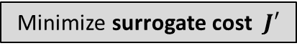
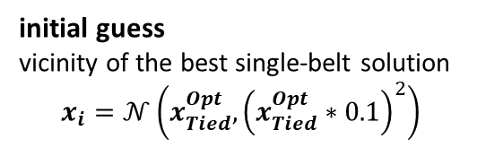
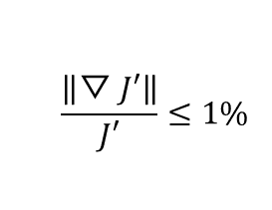
A family of feasible solutions in basins around local optima were found
Evolutionary Optimization
Cost vs. variable for feasible solutions in one dimension
Minimize cost $J$
Cost
s.t.
Baseline Trajectories
$$θ_{baseline}$$
Equations of motion
Treadmill Belt Speeds
$$V_{slow} ; V_{fast}$$
Optimization Variable, e.g., stride time
&
final position constraints
Neural
Network
Gradient Descent with multiple starts
Minimize surrogate cost $J′$
Regions of surrogate cost landscape with potential good-enough solutions
s.t.
Cost surrogate function for feasible solutions shown in one dimension
Cost
Initial & final position constraints
Cost
initial guess
vicinity of the best single-belt solution
$$x_{i}=𝒩\left(x_{Tied}^{Opt},{\left(x_{Tied}^{Opt}∗0.1\right)}^{2}\right)$$
stop search when
$$\frac{\left.\left\|▽J′\right.\right\|}{J′}≤1\%$$
$$▽^{2}J^{′}≻0$$
&
Optimization Variable, e.g., stride time
Optimization Variable, e.g., stride time

Slide 20
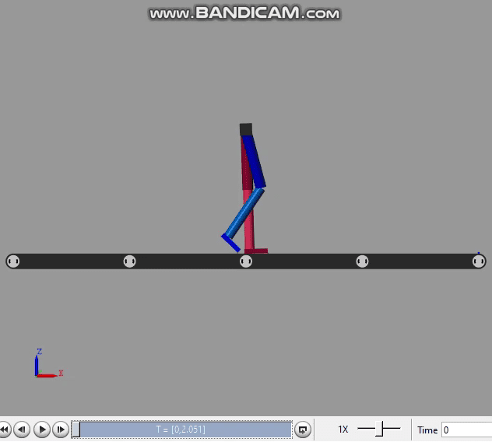
Simulations for different belt speed ratios showed realistic gait
Single-belt walking
(1.0 m/s)
Dual-belt walking
(0.75:1.25 m/s)
20

Slide 21
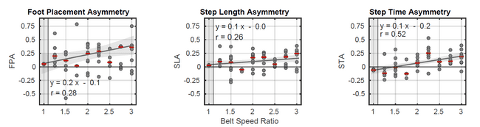
Asymmetry Feature Predictions Increased with Belt Speed Ratio
The predicted asymmetry values were generally positive
Median
21

Slide 22
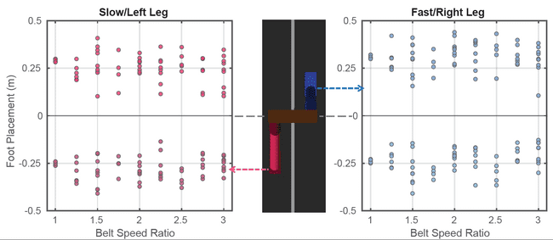
The biped generally stepped further forward on the fast belt
Slow
Fast
22

Slide 23
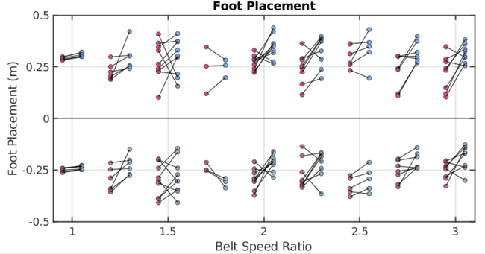

The biped generally stepped further forward on the fast belt
Predictions: 1) Placing the foot relatively further forward on the fast belt
2) Smaller leg extension upon push-off on the fast belt
Slow
Fast
23

Slide 24








The foot placement predictions agree with physics-based hypotheses
1) Placing the foot further forward on the fast belt
➔ Treadmill performs positive work on the biped
2) Smaller leg extension upon foot-off on the fast belt ➔ requires less push-off power by legs
$$F$$
$$Work=\int_{t_{HS}}^{t_{HS}+δ}{\vec{F}.\vec{V}dt}$$
$$V_{Slow}$$
$$V_{Fast}$$
$$V_{Fast}$$
$$V_{Fast}$$
$$V_{Slow}$$
24
[1] Sanchez et al., J Physiol (2019)

Slide 25

Net Positive and Net Negative Work Rate Values Generally Decreased with Belt Speed Ratio
Median
Positive work rate by legs generally decreased compared to baseline
Significant decrease in positive work by fast leg
Negative work rate by legs generally decreased compared to baseline
Significant decrease in negative work by slow leg
25

Slide 26

We predicted shorter stance time and longer swing time for the fast leg

Slide 27

Good-enough predictions were closer to empirical asymmetry values than optimality predictions
Empirical Observations
Prior Simulation Predictions
27

Slide 28
Key Points
Developed an evolutionary-gradient-based search algorithm that used gradient thresholding to find families of good-enough solutions for split-belt gait
Could explain the variability observed within individuals’ gait features
The good-enough search algorithm predicted generally positive values for asymmetry features that helped reduce the net positive work rate required by legs
The family of potential good-enough solutions could predict the empirical observations of gait asymmetry features better than strict optimality
Other principles than optimality, such as feasibility or good-enough control may explain action selection in individuals
28

Slide 29



Potential Applications of Predictive Simulations
Make predictions in novel conditions
Adaptive walking; how do people change in novel conditions?
Make predictions prior to interventions
Predict how behaviors might vary given cost and neuromotor impairment
Iterative design of neuroimpaired gait rehabilitation prior to experiments
Prosthetic legs
Surgeries and FES
| 3
29

Slide 30

Energy Economy Alone Fails to Fully Predict All Gait Features
Walk-run transition occurs at slower speeds than energy-optimal ¹
Preferred : V = 2.07 ± 0.12 m/s
Energy-optimal: V = 2.25 ± 0.10 m/s
| 3
30
[1] Hreljac, O J of Ame Colleg of Sports Medicine (1993). [2] Hunter et al., J Biomech (2010).
[3] Darter & Wilken, Prosthetics and Orthotics Int (2014). [4] Reisman et al., Neurorehabil Neural Repair (2009).

Slide 31

Energy Economy Alone Fails to Fully Predict All Gait Features
Walk-run transition occurs at slower speeds than energy-optimal ¹
Preferred downhill walking not driven by energy economy ²
stability matters
Self-selected speeds in other populations do not minimize energy
Amputees wearing prosthesis ³
hemiparetic gait ⁴
Likely that a compromise among several factors influence how we choose to walk across various contexts
| 3
31
[1] Hreljac, O J of Ame Colleg of Sports Medicine (1993). [2] Hunter et al., J Biomech (2010).
[3] Darter & Wilken, Prosthetics and Orthotics Int (2014). [4] Reisman et al., Neurorehabil Neural Repair (2009).

Slide 32


Inverse Optimization Used to Infer the Costs from Behavior
Given a behavior, obtain a cost function for which the behavior is optimal ¹
$$C=w_{1}C_{1}+…+w_{n}C_{n}$$
Attempt to recover the true cost weights by minimization of behavior predictions error
The behavior generated by the inferred costs would be compared to experimental patterns
| 3
32
[1] Kalman, Joint Auto Cont Conf, 1963. [3] Nguyen et al., IEEE TNSRE, 2019. [5] Rebula et al., IEEE RAL, 2019.
[2] Thau, IEEE Trans on Auto Cont, 1967. [4] Veerkamp et al., J Biomech, 2021. [6] Clever & Mombaur, Robotics Sci & Sys, 2016.

Slide 33
Knowledge Gap: Correlated Costs
Many candidate cost components may be highly correlated
e.g., changes in mechanical work may be correlated with metabolic cost across a range of walking speeds
A dimensionality reduction in the cost space would extract independent cost bases, resolving multicollinearity
| 3
33

Slide 34
Knowledge Gap: Uncertainty in inference
Minimization of multiple sets of costs could give rise to the same behavior
Bayesian inference could find distributions of cost weights that predict a given behavior
| 3
34

Slide 35
Specific Aim 2
Develop a novel inverse optimization approach to
Account for redundancy in the space of potential costs
Perform dimensionality reduction in the space of candidate costs
Account for uncertainty in the inference
Identify distributions of plausible locomotor cost weights through Bayesian inference
We hypothesized that
Hypothesis 2a: Feature-Reduced Inference will recover the true weights on the costs equally or more accurately than the naïve approach
Hypothesis 2b: Feature-Reduced Inference will predict the reference behaviors equally or more accurately than the naïve approach
35

Slide 36





Assessment of cost multicollinearity using behavioral gait data
Limb
Cost Feature Space
36
[1] Fukuchi et al., PeerJ, 2018

Slide 37

Dimensionality reduction reduced 16 cost components to 5 cost bases
100
75
Cumulative VAF %
50
25
0
37

Slide 38




The feature reduction suggests presence of physiologically meaningful cost clusters
Energy – Effort
Kinematic Jerk
VAF = 56%
VAF = 19%
Effort Rate – Kinetic Jerk
VAF = 10%
…
38

Slide 39


We formed composite cost based on known sets of cost weights
A pool of Physiological Costs
Torque
A Set of Individual Cost Weights ($W^{costs}$)
Cost =
$$Σ C_{i}W_{i}^{costs}$$
Torque rate
Jerk
Work rate
⁞
39

Slide 40

Forward simulation was used to generate synthetic gait patterns
A pool of Physiological Costs
Forward Simulation of Gait
Torque
Cost =
$$Σ C_{i}W_{i}^{costs}$$
Minimize the Composite Cost
Cost = $Σ C_{i}W_{i}^{costs}$
A Set of Individual Cost Weights ($W^{costs}$)
Torque rate
Jerk
Work rate
⁞
Dynamics
40

Slide 41





We generated synthetic gait patterns at a range of treadmill speeds
41

Slide 42
Forward simulation was used to generate synthetic gait patterns
A pool of Physiological Costs
Forward Simulation of Gait
Torque
Cost =
$$Σ C_{i}W_{i}^{costs}$$
Minimize the Composite Cost
Cost = $Σ C_{i}W_{i}^{costs}$
A Set of Individual Cost Weights ($W^{costs}$)
Torque rate
Jerk
Work rate
⁞
Dynamics
42

Slide 43


We generated synthetic gait patterns at a range of treadmill speeds
A pool of Physiological Costs
Forward Simulation of Gait
Torque
Minimize the Composite Cost
Cost = $Σ C_{i}W_{i}^{costs}$
A Set of Individual Cost Weights ($W^{costs}$)
Cost =
$$Σ C_{i}W_{i}^{costs}$$
Torque rate
Jerk
Dynamics
Work rate
⁞
43

Slide 44

We performed Bayesian cost inference using the synthetic gait data
A pool of Physiological Costs
Forward Simulation of Gait
Torque
Minimize the Composite Cost
Cost = $Σ C_{i}W_{i}^{costs}$
A Set of Individual Cost Weights ($W^{costs}$)
Cost =
$$Σ C_{i}W_{i}^{costs}$$
Torque rate
Jerk
Dynamics
Work rate
⁞
Bayesian Cost Inference
44

Slide 45



Goal: Find the cost weight distributions that predict the reference behaviors
Bayesian Cost Inference
Forward Simulation (Behavior Predictions per Optimization)
Forward Simulation of Gait
Predicted
Reference Behaviors
Minimize the Composite Cost
Cost = $Σ C_{i}W_{i}^{costs}$
Dynamics
Update weights W based on a Markov-chain Monte-Carlo process
Accept or reject the proposed weights based on posterior probability
$$W$$
$$Intialize$$
$$W=U(0,1)$$

Slide 46

We compared the inference approaches via Kolmogorov-Smirnov test
A pool of Physiological Costs
Forward Simulation of Gait
Torque
Minimize the Composite Cost
Cost = $Σ C_{i}W_{i}^{costs}$
A Set of Individual Cost Weights ($W^{costs}$)
Cost =
$$Σ C_{i}W_{i}^{costs}$$
Torque rate
Jerk
Dynamics
Work rate
⁞
5 different weight sets
10 different inertial properties sets
Bayesian Cost Inference
Naïve IOC
$$Cost=W_{C_{1}}C_{1}+W_{C_{2}}C_{2}+W_{C_{3}}C_{3}+…+W_{C_{n}}C_{n}$$
1
Naïve Cost Inference
Feature-reduced IOC
$$Cost=W_{B_{1}}{\left[\begin{matrix}L_{11} \\ L_{21} \\ \begin{matrix}⋮ \\ L_{n1}\end{matrix}\end{matrix}\right]}^{T}\left[\begin{matrix}C_{1} \\ C_{2} \\ \begin{matrix}⋮ \\ C_{n}\end{matrix}\end{matrix}\right]+W_{B_{2}}{\left[\begin{matrix}L_{12} \\ L_{22} \\ \begin{matrix}⋮ \\ L_{n2}\end{matrix}\end{matrix}\right]}^{T}\left[\begin{matrix}C_{1} \\ C_{2} \\ \begin{matrix}⋮ \\ C_{n}\end{matrix}\end{matrix}\right]+…+W_{B_{N}}{\left[\begin{matrix}L_{1N} \\ L_{2N} \\ \begin{matrix}⋮ \\ L_{nN}\end{matrix}\end{matrix}\right]}^{T}\left[\begin{matrix}C_{1} \\ C_{2} \\ \begin{matrix}⋮ \\ C_{n}\end{matrix}\end{matrix}\right]$$
2
Feature-Reduced Cost Inference
Basis 1
Basis 2
Basis N

Slide 47


Behaviors recovered by inferred costs for Simulated Subject 1 and Weight Set 1
Reference Behavior
47

Slide 48

Both IOC approaches had equal behavioral predictive power
48

Slide 49

Cost Weight Posterior Distributions for Simulated Subject 1
49

Slide 50

The Feature-Reduced Inference Performed Better than the Naïve Inference in Cost Recovery
Better recovery
50

Slide 51
Key Points
The Feature-reduced Bayesian inverse optimization
Reduced the cost space dimension from 16 costs to 5 intuitive cost clusters
The first basis consisted of energetics with VAF ~ 57%, as expected
Provided a distribution of plausible cost component weights
A comparison between two Naïve and Feature-reduced approaches showed that
Both approaches predicted the reference behavior well
Feature-reduced approach recovered the cost weights better
Feature-reduced IOC provides a more parsimonious representation of costs that may give rise to an observed behavior
51

Slide 52
Potential Future Directions
Apply Feature-Reduced IOC to behavioral data
Infer cost weight distributions from a subset of behaviors
Make predictions for new walking speeds using the inferred costs
Hypothesis: The costs inferred by the Feature-Reduced approach would make more accurate behavioral predictions for new contexts than the Naïve approach or any individual classical cost would do
52

Slide 53


Implications & Potential Applications
Mechanistic understanding of human motor control
Objective-based motor assessment
Decipher the probable cause of gait abnormality
Transfer learning in bio-inspired robotics
53

Slide 54
Summary of Contributions
Our evolutionary-gradient-based search algorithm found families of good-enough solutions in split-belt gait
Locomotor strategies may be selected that are suboptimal but good-enough
Feature-reduced Bayesian inverse optimization provided a framework to resolve the cost multicollinearity and the uncertainty in inference for potentially even richer cost pools
A more parsimonious representation of costs that may give rise to observed behavior
A distribution of meaningful cost weights were inferred rather than a single weight set
Development of an inverse good-enough control that infers costs for which the reference behavior is good-enough
54

Slide 55
Acknowledgements
Dissertation Committee
Prof. James M Finley
Prof. Nicolas Schweighofer
Prof. Francisco Valero-Cuevas
Prof. Kristan Leech
Locomotor Control Lab
Current and former members
Family
My beloved mother and father
Suzanna
55

Slide 56

Thank You!
Pouria Nozari
nozaripo@usc.edu
Advisor: Prof. James M Finley
jmfinley@usc.pt.edu

